Slide 1
CUTTING MATERIAL
MANAGEMENT SYSTEM
SPIKE RELATED SCREEN SHOTS

Slide 2
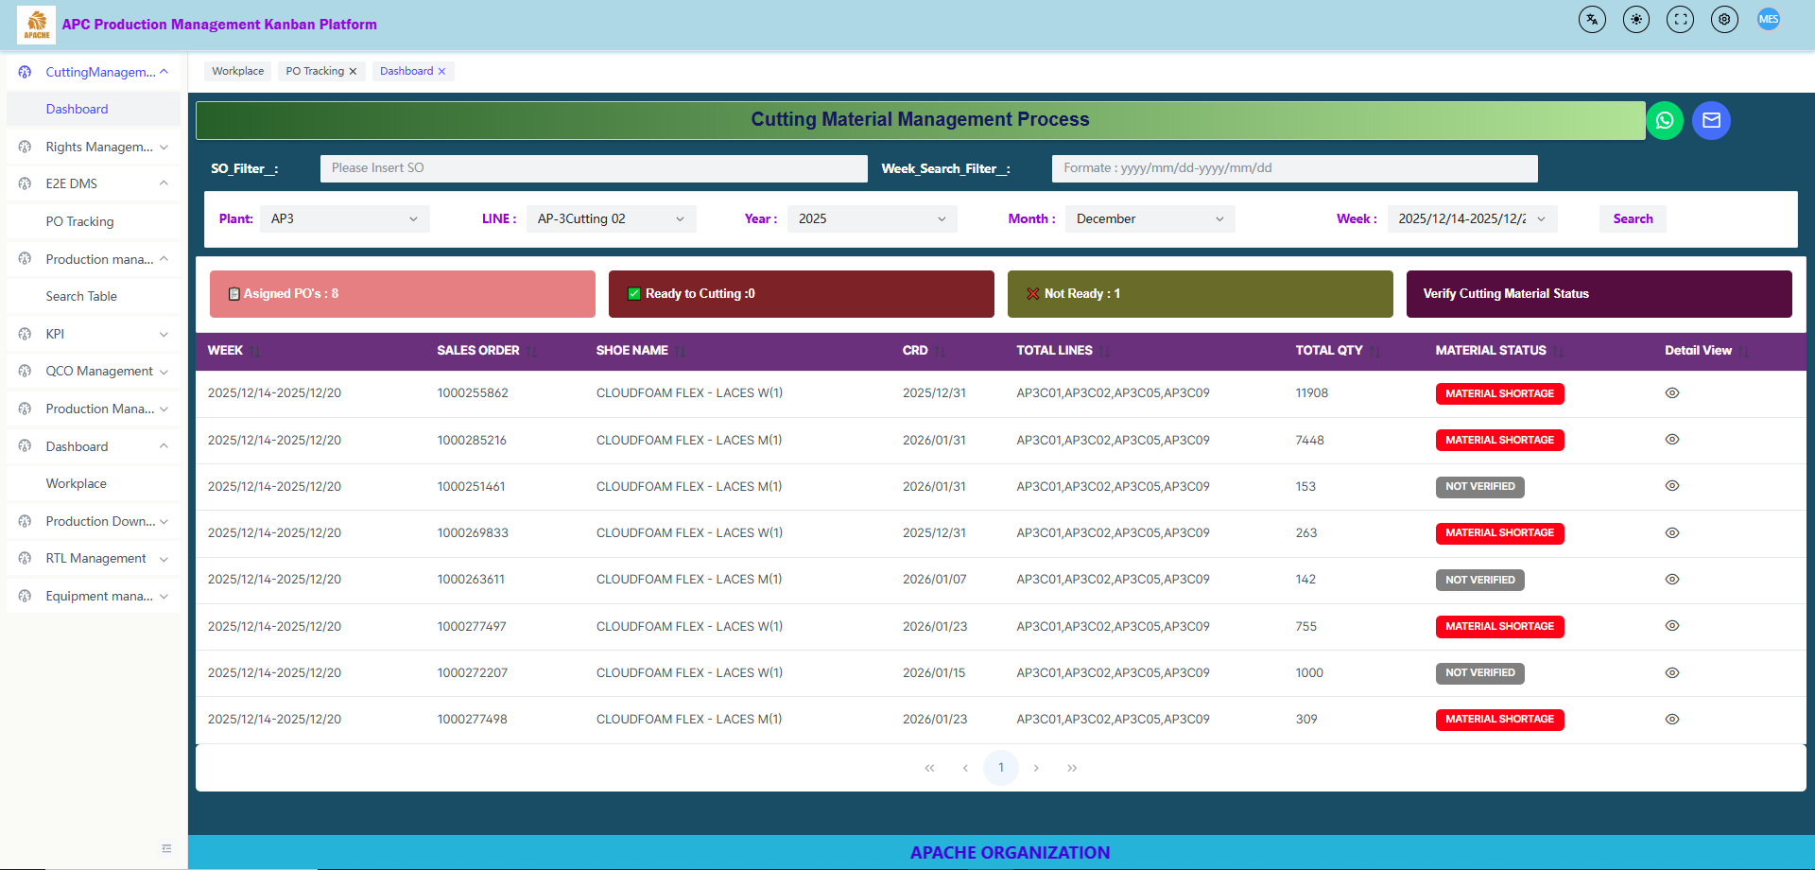

Slide 3
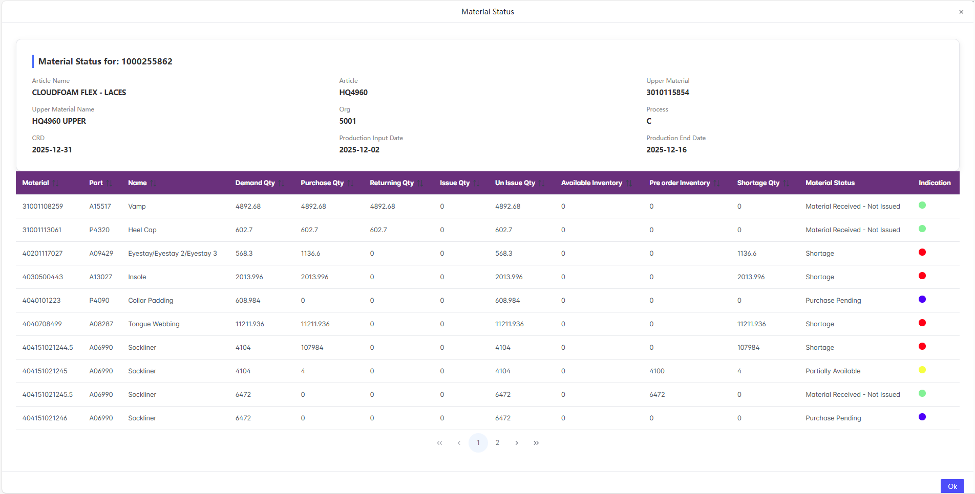

Slide 4
